Slide 1
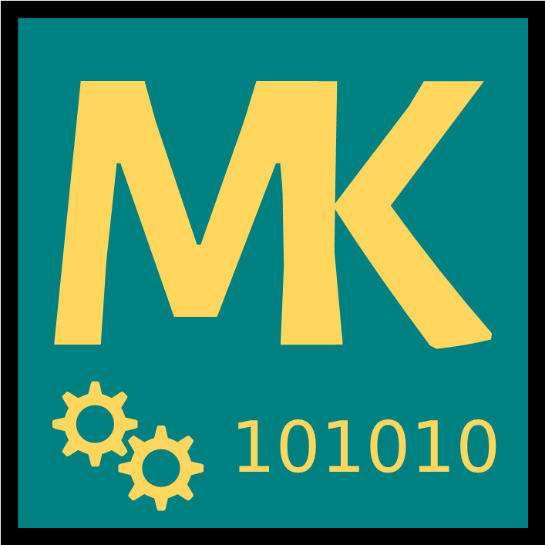
Remote User Interfaces for Machine Tools
Alexander Rössler, MSc

Slide 2
Overview
About Me
Machinekit
QtQuickVcp
Applications

Slide 3
About Me

Slide 4
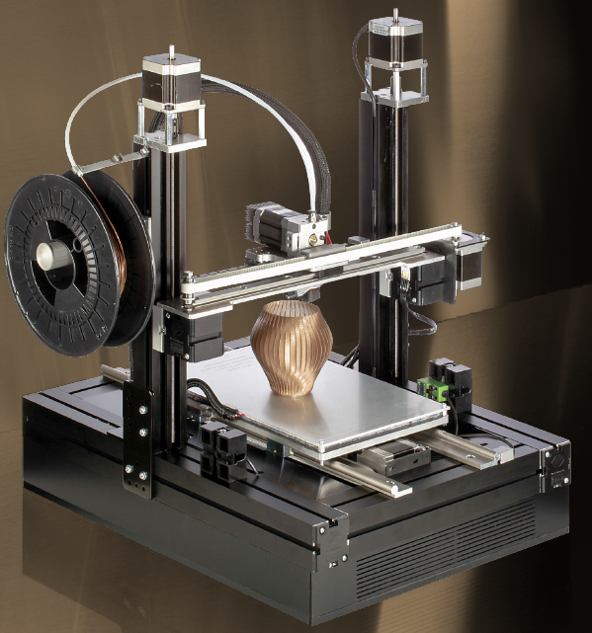
About Me
Alexander Rössler
Embedded Systems
Open Source
3D printing

Slide 5
Introduction

Slide 6
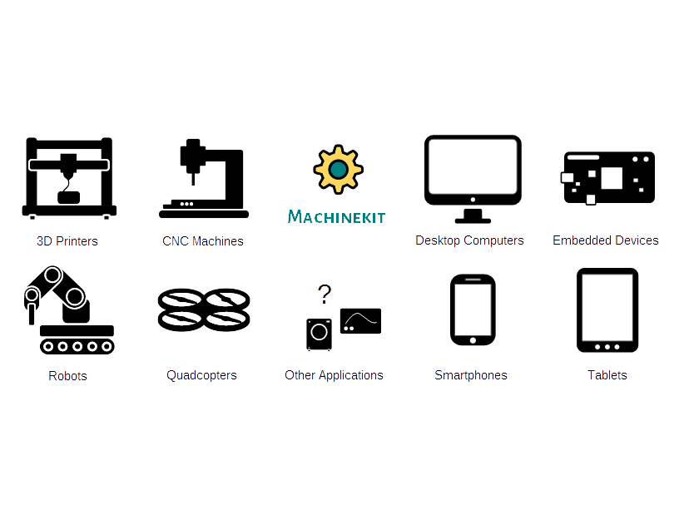
Machinekit

Slide 7
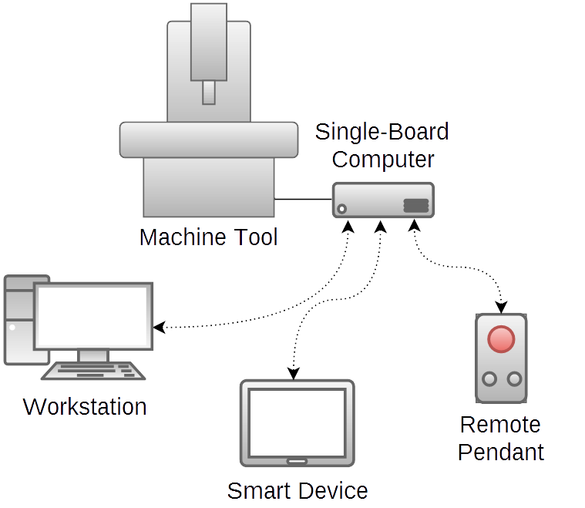
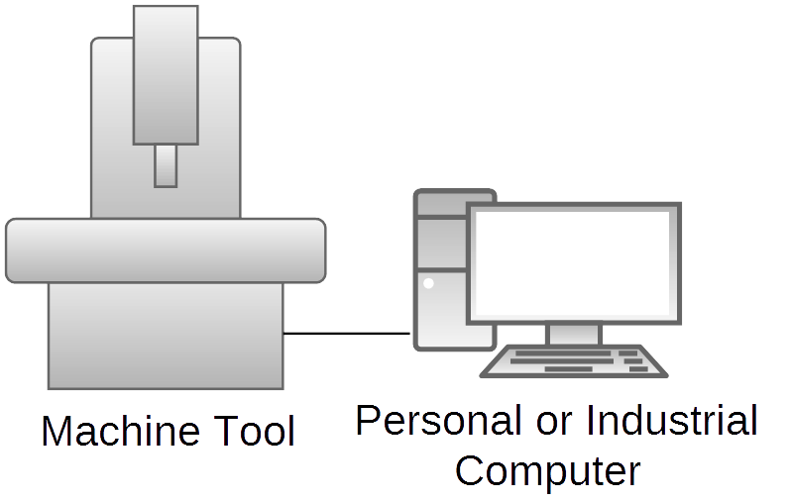
Traditional vs Remote UI
Monolithic System
Distributed System
→ Machinetalk

Slide 8
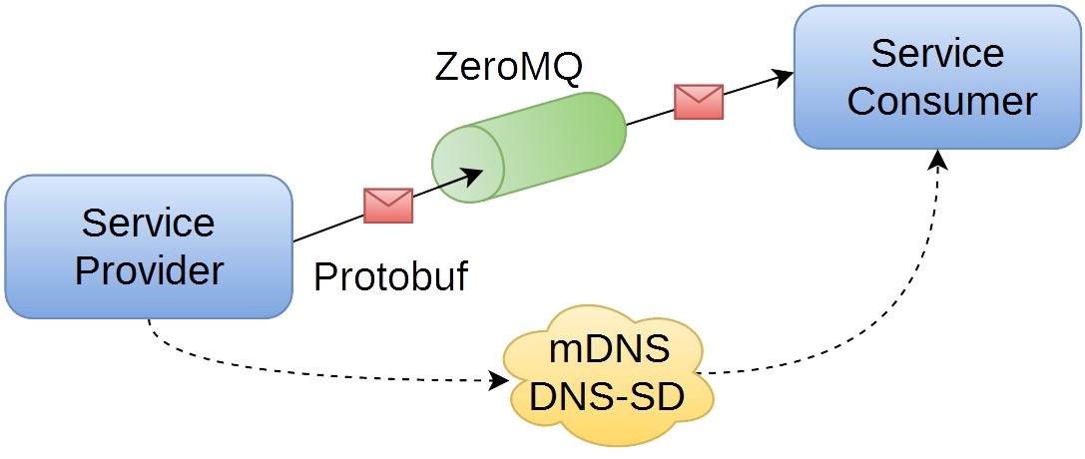
Machinetalk
Middleware
ZeroMQ - nzmqt
Protobuf
mDNS/DNS-SD - QJDns

Slide 9
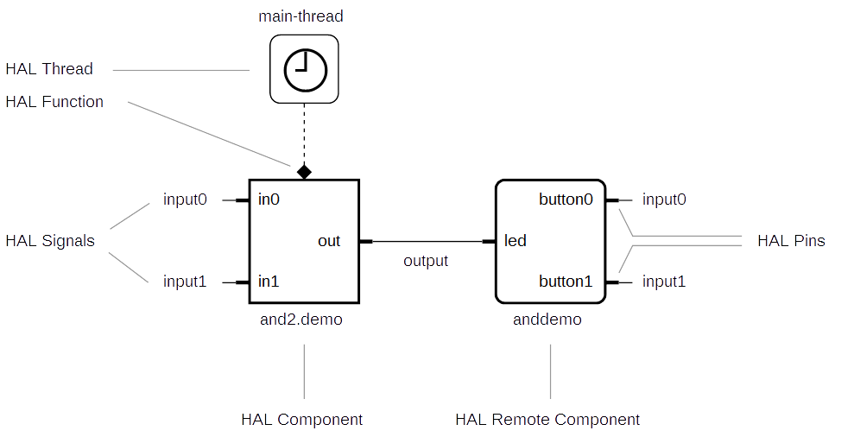
HAL

Slide 10
QtQuickVcp

Slide 11

QtQuickVcp
Virtual Control Panel
QML modules
Machinetalk
Cross platform

Slide 12

Remote Launching & Deployemnt
Start new instances
Deploy UI files
MachinekitClient

Slide 13
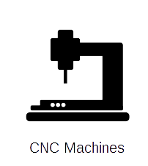
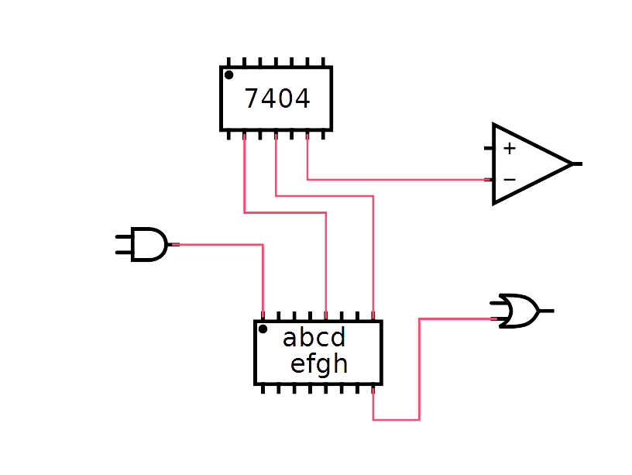
User Interfaces
2 types of user interfaces
  HAL Remote
  Application/EMC

Slide 14
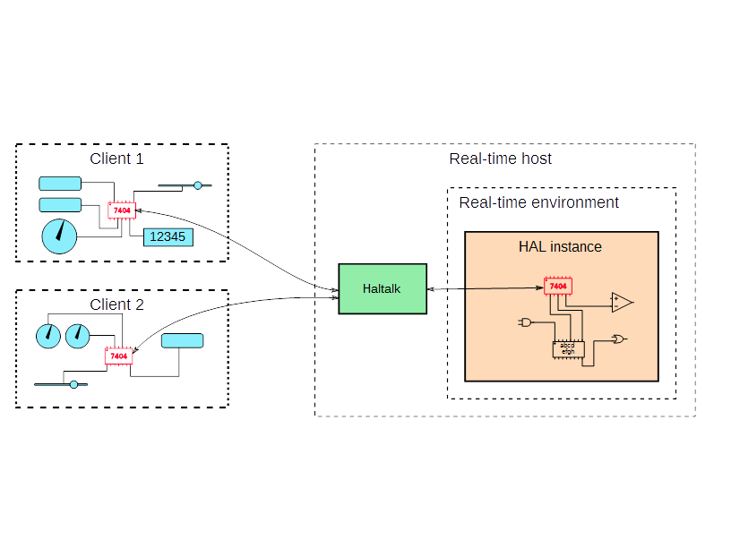
HAL Remote Components
Like normal components
Remote API

Slide 15
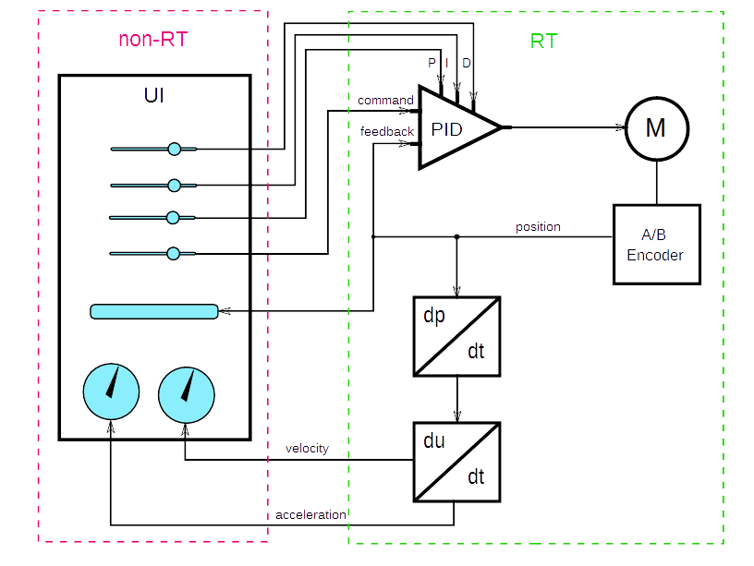
Example Application

Slide 16
Modules
Machinekit.Application
Machinekit.Application.Controls
Machinekit.HalRemote
Machinekit.HalRemote.Controls
Machinekit.Service
Machinekit.PathView
Machinekit.VideoView

Slide 17
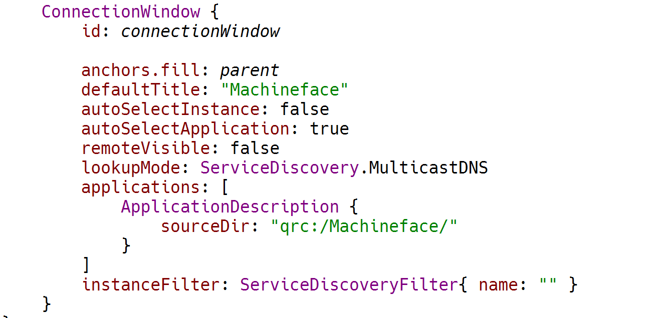
ConnectionWindow

Slide 18
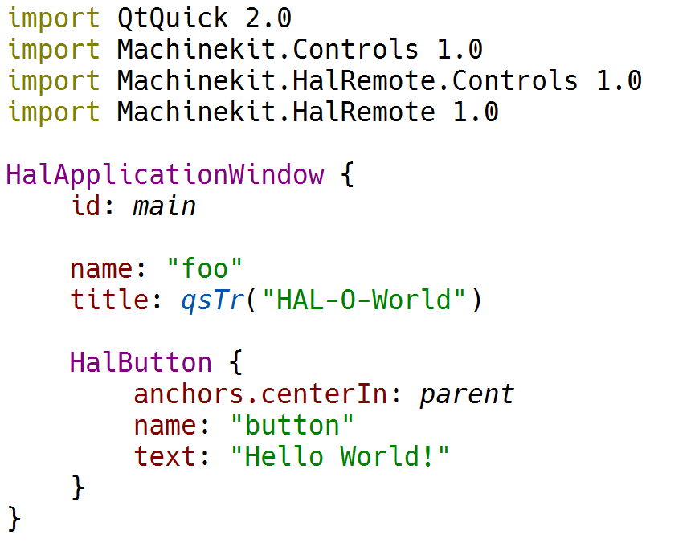
HAL Remote Components

Slide 19
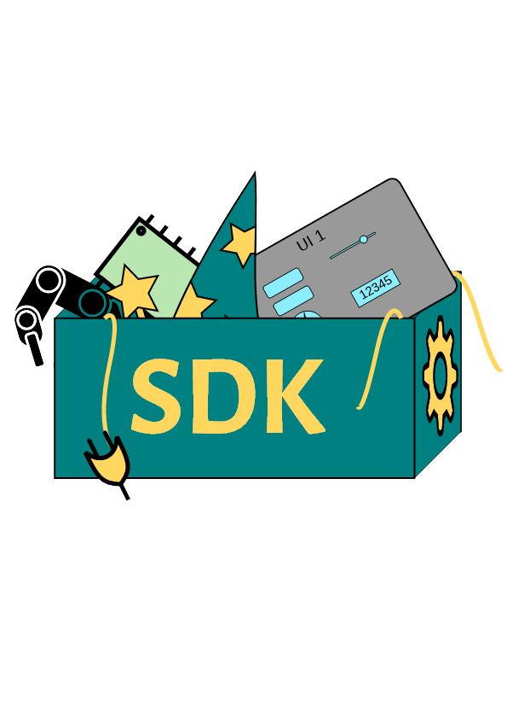
Machinekit SDK
Qt Creator
Wizards
Plugins
Templates

Slide 20
Applications

Slide 21
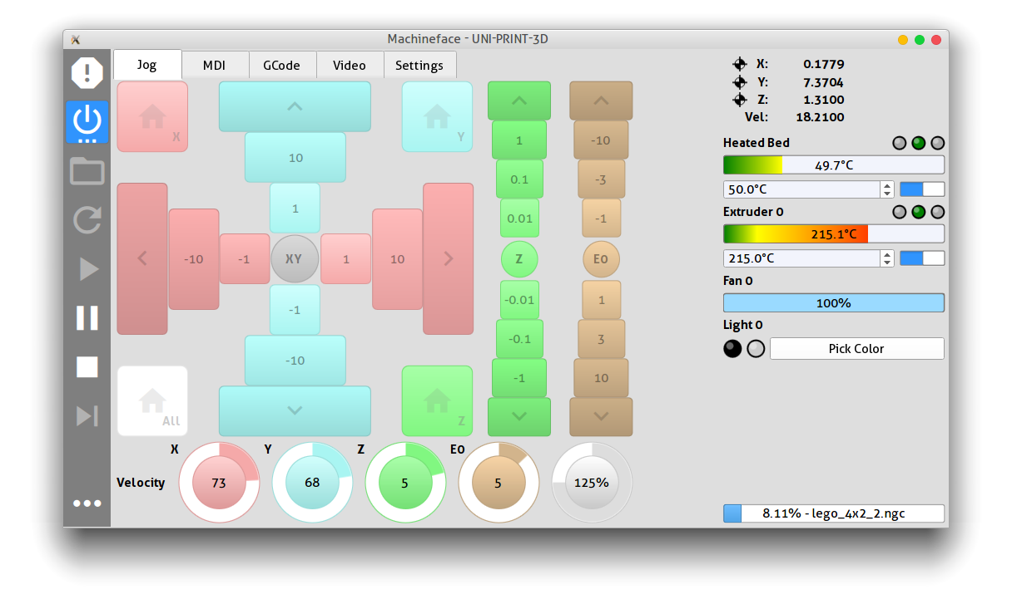
Machineface
3D printing

Slide 22
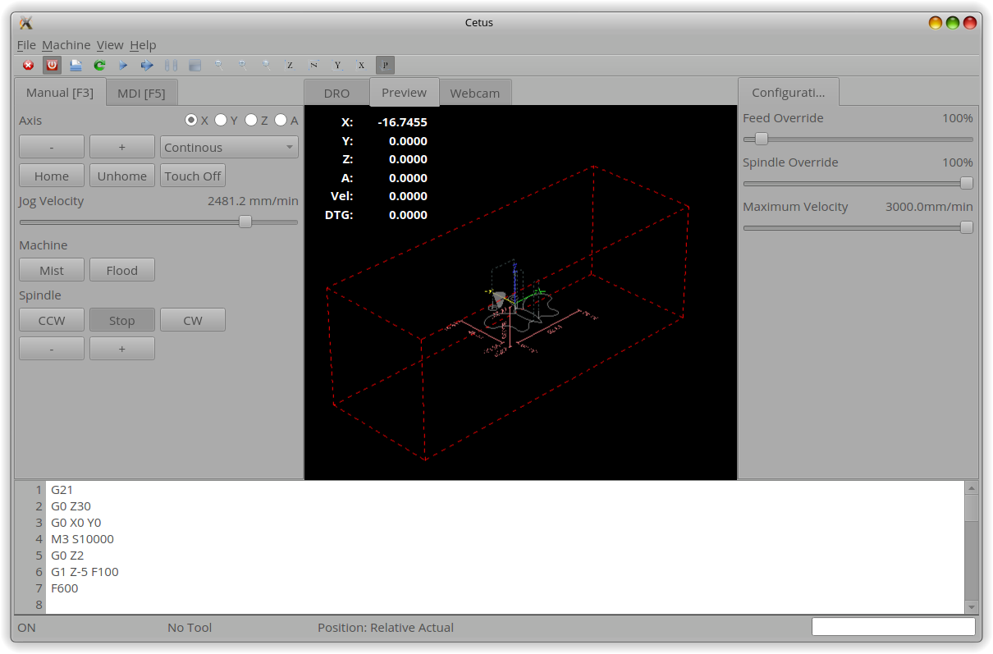
Cetus
CNC
Mill
Lathe
Router

Slide 23
Other Applications
Commercial CNC UI
Generic machine control UIs
“Small” applications
Prototyping
Testing
...

Slide 24
Links

Slide 25

More Information and Code
http://machinekoder.com
http://machinekit.io
https://github.com/machinekoder/QtQuickVcp
https://github.com/machinekoder/machinekit-vagrant
https://github.com/machinekoder/MachinekitSDK

Slide 26
Future

Slide 27
Future
Qt Creator
MachinekitSDK
WYSIWYG/CMS editor
Graphical HAL editor

Slide 28
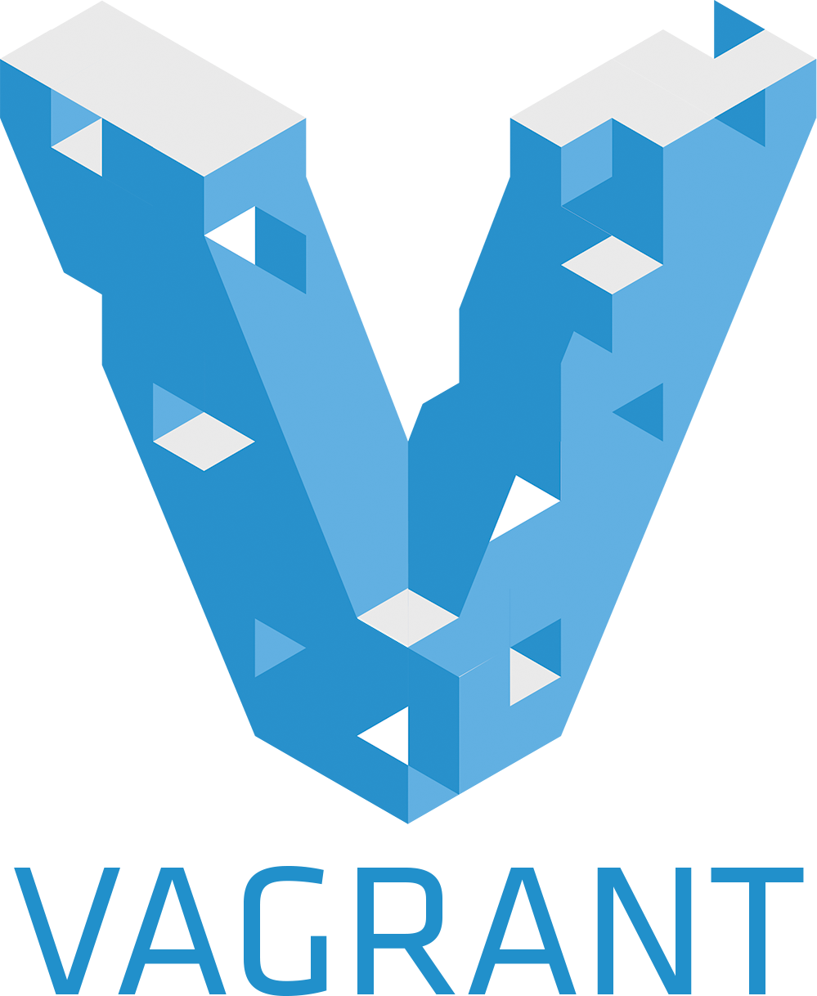
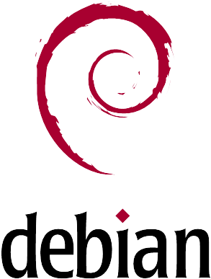
Vagrant Box
VirtualBox
Jessie
LXDE
Machinekit packages
Qt SDK
Git repostories
https://github.com/strahlex/machinekit-vagrant

